Slide 1

Predictive modeling for flight delays
Presented By-
Ankit Akash​

Slide 2
Defining the problem
Definition of the problem: Predicting flight delays using machine learning algorithms.
Task: Develop an efficient model to predict the delay of flight based on various features.
Importance:
Flight delays: Flight delays are identified as a significant problem in the aviation industry.
Cost implications: Flight delays incur significant costs for both airlines and passengers.
Operational disruptions: Delays lead to operational disruptions for airlines.
Customer dissatisfaction: Flight delays result in dissatisfaction among passengers.
Financial losses: Airlines experience financial losses due to flight delays.
Importance of punctuality: Punctuality is emphasized as crucial in the airline industry, highlighting the seriousness of flight delays.
Cascading effects: Flight delays can have cascading effects on operations and customer satisfaction.

Slide 3
explaining Business problem
Business Problem: Accurately predicting flight delays within the aviation industry.
Consequences: The core issue lies in accurately forecasting flight delays within the aviation industry. Such delays bring significant costs and disruptions for both airlines and passengers, leading to dissatisfaction, operational inefficiencies, and financial setbacks.
Purpose: By enhancing the ability to predict when delays might occur, airlines can proactively manage their schedules, allocate resources more effectively, and improve the overall passenger experience.
Stakeholders: Airlines, passengers, airport authorities, and other related industries.

Slide 4
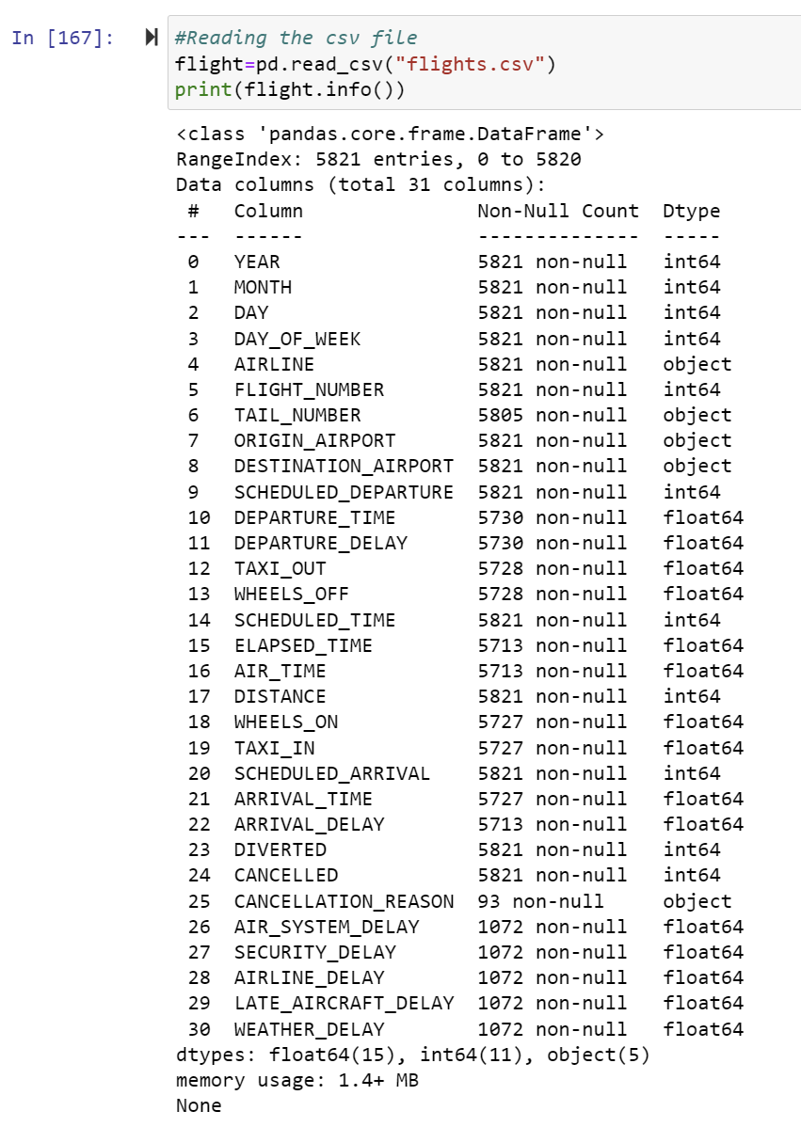
Dataset Overview
Source: The dataset is been gathered from Kaggle website and read from "flights.csv". It contains the dataset that consists of domestic flight details including factors that influence air travel disruptions for the year 2015.
Features:
LATE_AIRCRAFT_DELAY: Delay caused by aircraft AIRLINE_DELAY: Delay caused by the airline AIR_SYSTEM_DELAY: Delay caused by air system WEATHER_DELAY: Delay caused by weather DEPARTURE_TIME: WHEEL_OFF - TAXI_OUT DEPARTURE_DELAY: Total Delay on Departure DISTANCE: Distance between two airports
Target Variable:
ARRIVAL_DELAY: ARRIVAL_TIME - SCHEDULED_ARRIVAL

Slide 5
Algorithm Selection
Three different algorithms are chosen:
Linear Regression:
Simple and interpretable model.
Works well with linear relationships between features and target variable.
Random Forest Regression:
Ensemble learning method.
Handles non-linear relationships and interactions between features effectively.
Less prone to overfitting compared to individual decision trees.
OLS Regression:
Ordinary Least Squares regression.
Provides coefficients for each feature, allowing interpretation of their impact on the target variable.
Reasons for Selection:
Linear Regression and OLS Regression for their simplicity and interpretability.
Random Forest Regressor for its ability to capture complex relationships and handle non-linear data patterns.

Slide 6
REGRESSION MODEL FOR FLIGHT DELAY
APPLICATION OF LINEAR REGRESSION FOR DELAY PREDICTION:
Linear Regression is employed to forecast delays by analyzing historical data alongside factors such as aircraft delays and weather conditions.
It offers a straightforward technique to predict the duration of delays and how they affect flight schedules.
BENEFITS OF RANDOM FOREST AND OLS REGRESSION:
Random Forest provides reliable predictions by incorporating multiple decision trees and excels at managing intricate relationships within delayed data.
OLS Regression furnishes accurate coefficients for factors impacting delays, facilitating comprehension and enhancement of operational efficiency within the aviation industry.

Slide 7
Variable Preprocessing and Feature Selection
Steps involved in Variable Pre-Processing and Feature selection include:
• Handling missing values: Missing values in the 'DEPARTURE_DELAY' and 'ARRIVAL_DELAY' columns are dropped as they are crucial for the prediction task.
• Numerical features: Selected numerical features including 'LATE_AIRCRAFT_DELAY', 'AIRLINE_DELAY', 'AIR_SYSTEM_DELAY', 'WEATHER_DELAY', 'DEPARTURE_TIME', 'DEPARTURE_DELAY', and 'DISTANCE’.
• Categorical features: Categorical dummy variables are added for feature encoding.

Slide 8
Performance Indicators
Evaluation Metrics:
Mean Squared Error (MSE): Measures the average squared difference between the predicted and actual flight arrival delays. Lower MSE indicates better predictive performance.
R-squared (R²): Represents the proportion of the variance in the flight arrival delays that is explained by the predictors. Higher R² values signify better model fit
Explanation:
MSE and R² are commonly used metrics to assess the predictive accuracy and goodness-of-fit of regression models.
These metrics provide insights into how well the models are performing in predicting flight arrival delays based on the selected features.
By analyzing MSE and R², we can determine the effectiveness of the chosen algorithms (Linear Regression, Random Forest Regressor, and OLS Regression) in capturing the underlying relationships between the predictors and the target variable.

Slide 9
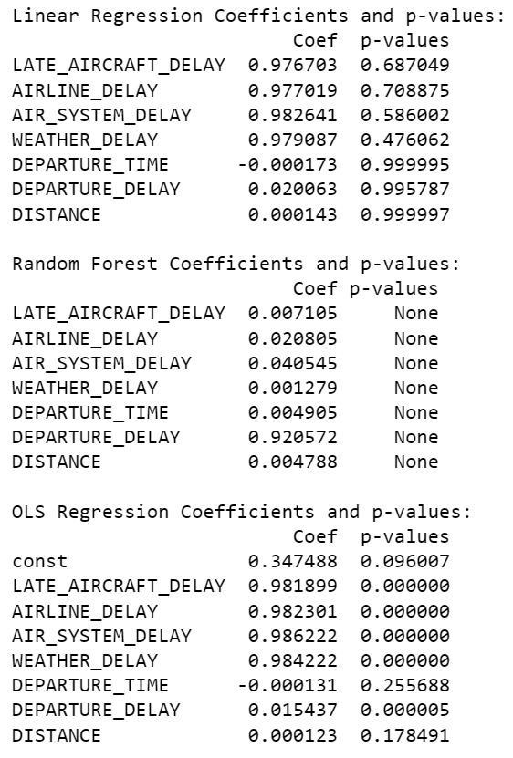
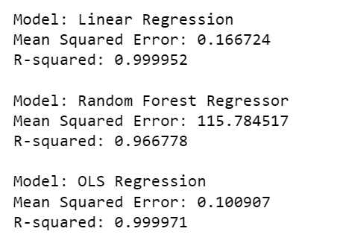
MODEL EVALUATION
Results:
Linear Regression:
Mean Squared Error: 0.166724
R-squared: 0.999952
Random Forest Regressor:
Mean Squared Error: 115.784517
R-squared: 0.966778
OLS Regression:
Mean Squared Error: 0.100907
R-squared: 0.999971
Observations:
Linear Regression and OLS Regression perform exceptionally well with high R-squared values close to 1.
Random Forest Regressor has a relatively higher MSE and lower R-squared compared to the other models, indicating less predictive accuracy.

Slide 10
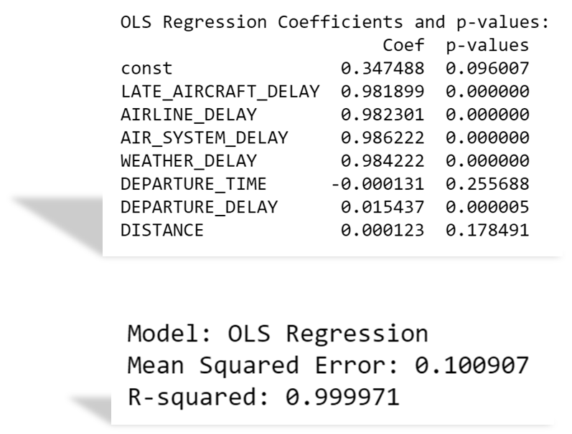
Result
The one that worked the best was OLS Regression using statsmodel with R-squared score: 0.999971.
This output obtained from this algorithm has
Low Mean-squared error
High R-squared value
Statistically significant coefficients, as the independent variables have low-p values

Slide 11
Conclusion
In summary, accurately predicting flight delays is crucial for airlines. Predictive modeling helps them anticipate and manage disruptions, reducing financial losses and improving the passenger experience. By investing in these models, airlines can optimize resources, enhance operational efficiency, and stay competitive in today's customer-focused market. In essence, accurate flight delay prediction is not just about avoiding problems; it's about ensuring smooth operations and satisfied customers.
Applications:
Predict flight delay.
To provide an efficient strategy to tackle with the Airline’s yield management systems.
Same model can be used to predict the delay of other transportation.

Slide 12
THANK YOU

